Slide 1
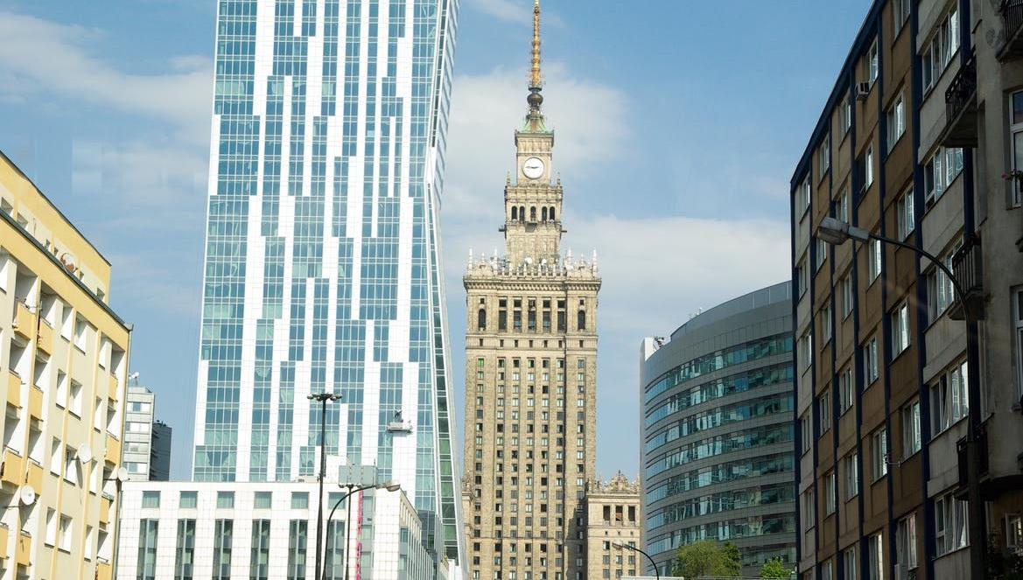

How can Poland effectively fund energy-efficient buildings?
November 21, 2017
Bringing PACE to Europe

Slide 2

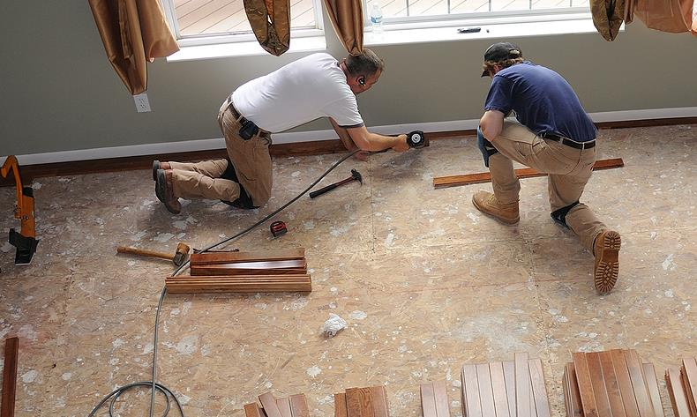

Home Renovation Can Be Difficult and Stressful

Slide 3
Two-Step Innovation
PACE Financing – Keys to Success
Investor-friendly
People-centric
Long-term financing
Security and Repayment mechanism
Simple & Digital
Fast Approval
Trusted Contractors
Financing
Deployment

Slide 4

Financing
Investor-friendly
1
2
Up-front Financing
Long-term repayment
3
4
Stays with the property
Collection Mechanism
Property taxes
Lien on the property
Delinquency and Default remedies

Slide 5




People-Centric Deployment
Australia
$398m
Tokyo
$1000m
London
$527m
Digital and Customer Oriented
Trusted Contractors
No Impact on Personal Credit
Comfort and Savings

Slide 6

What is PACE?
Simple and effective platform for home renovation.
Voluntary on-tax financing, repaid with property taxes
Flexible Public-private partnership
Financing attached to a home, not a person
Affordable financing for up to 25 years

Slide 7


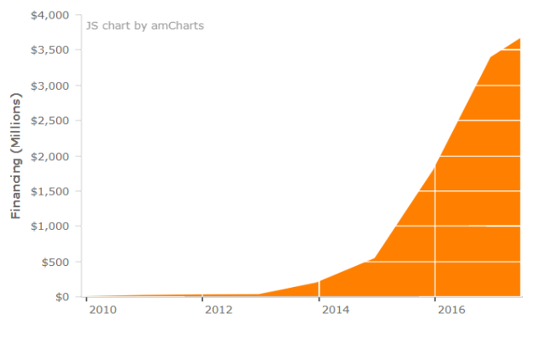

$4.7 Billion Invested in Projects
1.1 Million Cars Taken Off the Road
200,000 Homeowners used PACE to improve their homes
40,000
Local Jobs Created
Residential PACE Data
Improvement Breakdown, R-PACE
EE – 58%
RE – 37%
Water - 4%

Slide 8

A Global Perspective
It Is Time to Bring PACE to Europe
Europe
Canada
GNE Finance: Committed to Developing
PACE Programs in Development in Ontario and Alberta.
United States
More Than $4 Billion in Funded Projects, 34 States, 2,000+ Cities, 50,000+ Jobs Created.
Australia
South Africa
Environmental Upgrade Agreements (EUA) Funded Over $20M Worth of Sustainable Improvements.
PACE Program in Development in Cape Town.

Slide 9




European Perspective
It Is Time to Bring PACE to Europe
01
02
03
04
EU Policy
Member States
Buildings
People
Ambitious 2030 policy goals, building upon COP 21 Paris Agreement.
There are leaders and laggards. We need to close the gap between Member States.
The majority of European buildings are inefficient. 75-90% will still be in use in 2050.
Buildings effect peoples’ comfort, wellbeing and productivity. Many live in energy poverty.

Slide 10
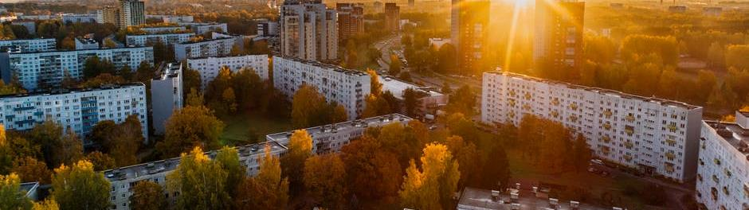
European Buildings
It Is Time to Act
Renovation Rate Must Increase from 1.2% to 3%
To meet EU goals, $1.3 trillion needs to be invested in building efficiency from 2014-2035
25%
75%
75%
80%
Commercial
Residential
Will be in use in 2050
Were built before 1990

Slide 11
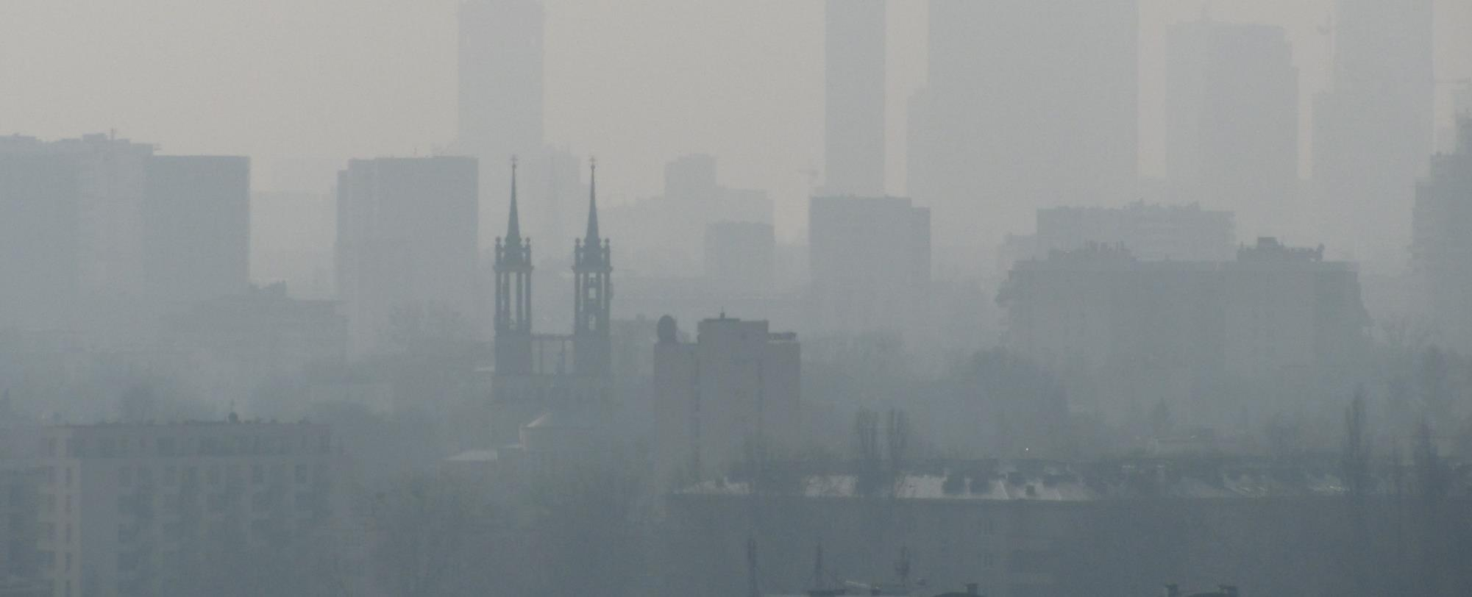
“Air Pollution is the world's single biggest environmental health risk” The World Health Organization
In Europe, poor air quality is the top environmental cause of premature deaths, causing more than 100,000 premature deaths a year and costing from £300bn-£800bn a year in extra health costs.
Source: Institute of Environmental Economics
70% of single-family homes in Poland are in need of renovation
Heating system modernisation and boiler replacement are key priorities
Renovation Need:
34% - heating system and boiler
26%- roof renovation
26% - insulation

Slide 12

European Citizens
It Is Time to Act
90 % of time is spent indoors
11 % live in fuel and energy poverty
91% of European citizens see climate change as a serious problem and 92% of support national action on improving energy efficiency by 2030
More and more people work part-time and from home (e.g. in the NL up to 47% work part-time and more than 4 million Britons work from home)
Health, Comfort, and Energy Savings

Slide 13
EuroPACE: Adapting PACE to Europe
EuroPACE Brings it all Together
Building on the EU and Member State Policy Goals
Empowering European Citizens
Embracing Digitalization and Consumer Focus
Boosting Energy Efficiency Investment in Buildings

Slide 14

EuroPACE Project Summary
Horizon 2020 Project
A new paradigm for energy efficiency financing
€ 2.4 Million
7 partners from 4 countries
March 2018 – March 2021
I. Market-Based Approach
II. Assistance to Homeowners
III. De-Risking
IV. Aggregation
V. Public-Private Partnership

Slide 15
EuroPACE Project Achievements
Stats and Figures
Interest from Investors Representing
Support from Major US PACE Providers
80+
18
€5bn
3
Letters of Support
Local and National Advocates
15 Countries
13 Countries
Investment Funds
Renovate America
30 + Cities
SMEs and Non-profits
Impact Investors
Renew Financial
8 Regions
Think tanks and Universities
Foundations
Ygrene

Slide 16

Let’s join forces
Private and Public sectors must work together to enable Energy Transition and the Low-Carbon Economy.
Let’s get in touch:
Kristina Klimovich
k.Klimovich@gnefinance.com

Slide 17
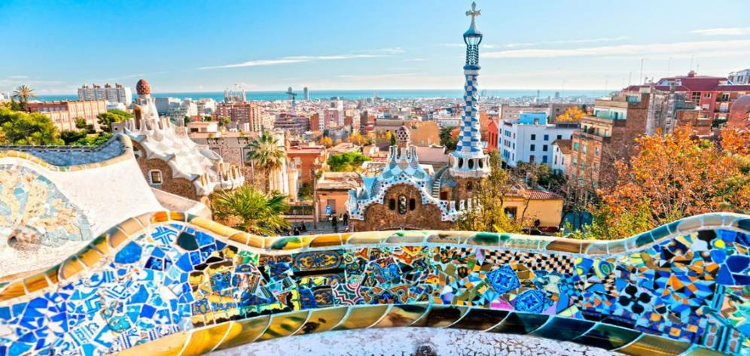
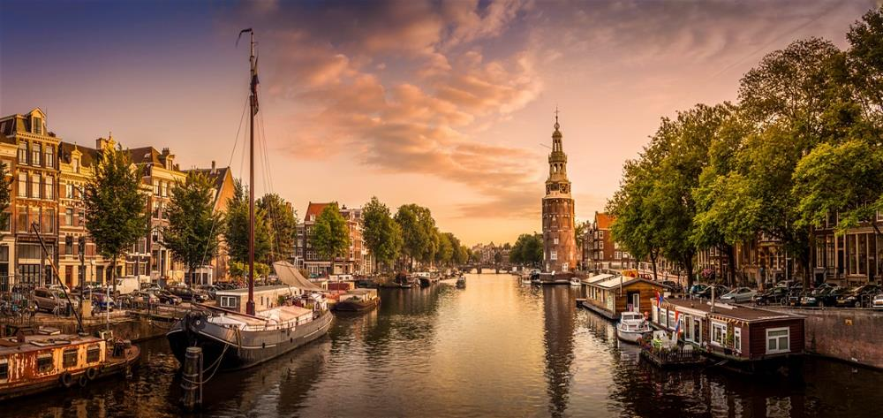
Barcelona
Amsterdam
“PACE Leverages a Divest Approach to Achieve Climate Goals”

