Slide 1

Effort Sharing
And new low-carbon funds
Phil MacDonald (Standing in for Aleksandra Mirowicz)
@sandbagorguk
Notes:
Intro Sandbag

Slide 2
Summary
Large ETS funds are available for CEE states for low-carbon investment – especially in energy efficiency
Carbon trading in the ESR could bring in further funds from higher income Member States
The ESR cap needs to be tightened to avoid a large surplus damaging this potential market
Notes:
Why CCS, I’ll jump over, but it’s essential. How CCS has become unfortunately unavoidable
Then why greens aren’t backing it: Excuse for more fossil fuels.
Tentative early support for industrial… Bellweather: UK green party now supports it for gas in transition and industry, plus BECCS
How to get them to back it?
Coal + CCS link. Environmentalists have failed to embrace CCS because they see the fossil fuel industry using it as a figleaf.
In reality, emissions scenarios show world needs immediate and rapid reduction in fossil fuels PLUS massive negative emissions
CCS is not the panacea it’s made out to be for continued oil, coal and gas use. The industry will have to transition, and the sooner that’s admitted, the sooner greens will get on board
Not possible to “emit now, clean up later”
Rather, we have to bring emissions to zero very rapidly, and start negative emissions CCS at scale as soon as possible to clean up the mess already created

Slide 3
ETS Funds
Modernisation and Just Transition: 310 million allowances
Innovation Fund: 450 million allowances
(Plus Article 10c. For power sector)
Carbon price currently €7.50

Slide 4
Size of the funds
Country | Modernisation Fund (million t) | Art. 10c allocation (million t) | Total allowances (million t) | Total value at current ETS price (million €)
Poland | 135 | 440.1 | 574.7 | €4,310
Czechia | 48.3 | 179.55 | 227.85 | €1,709
Romania | 37.1 | 147.6 | 184.7 | €1,385
Bulgaria | 18.1 | 83.1 | 101.2 | €759
Hungary | 22.1 | 55.8 | 77.9 | €584
Slovakia | 19 | 53.25 | 72.25 | €542
Estonia | 8.6 | 28.35 | 36.95 | €277
Croatia | 9.7 | 18.9 | 28.6 | €215
Lithuania | 8 | 13.5 | 21.5 | €161
Latvia | 4.5 | 6.15 | 10.65 | €80
TOTAL | 310 | 1026.3 | 1336.4 | €10,023
Notes:
What these funds are worth is hugely dependent on the carbon price.
Currently

Slide 5
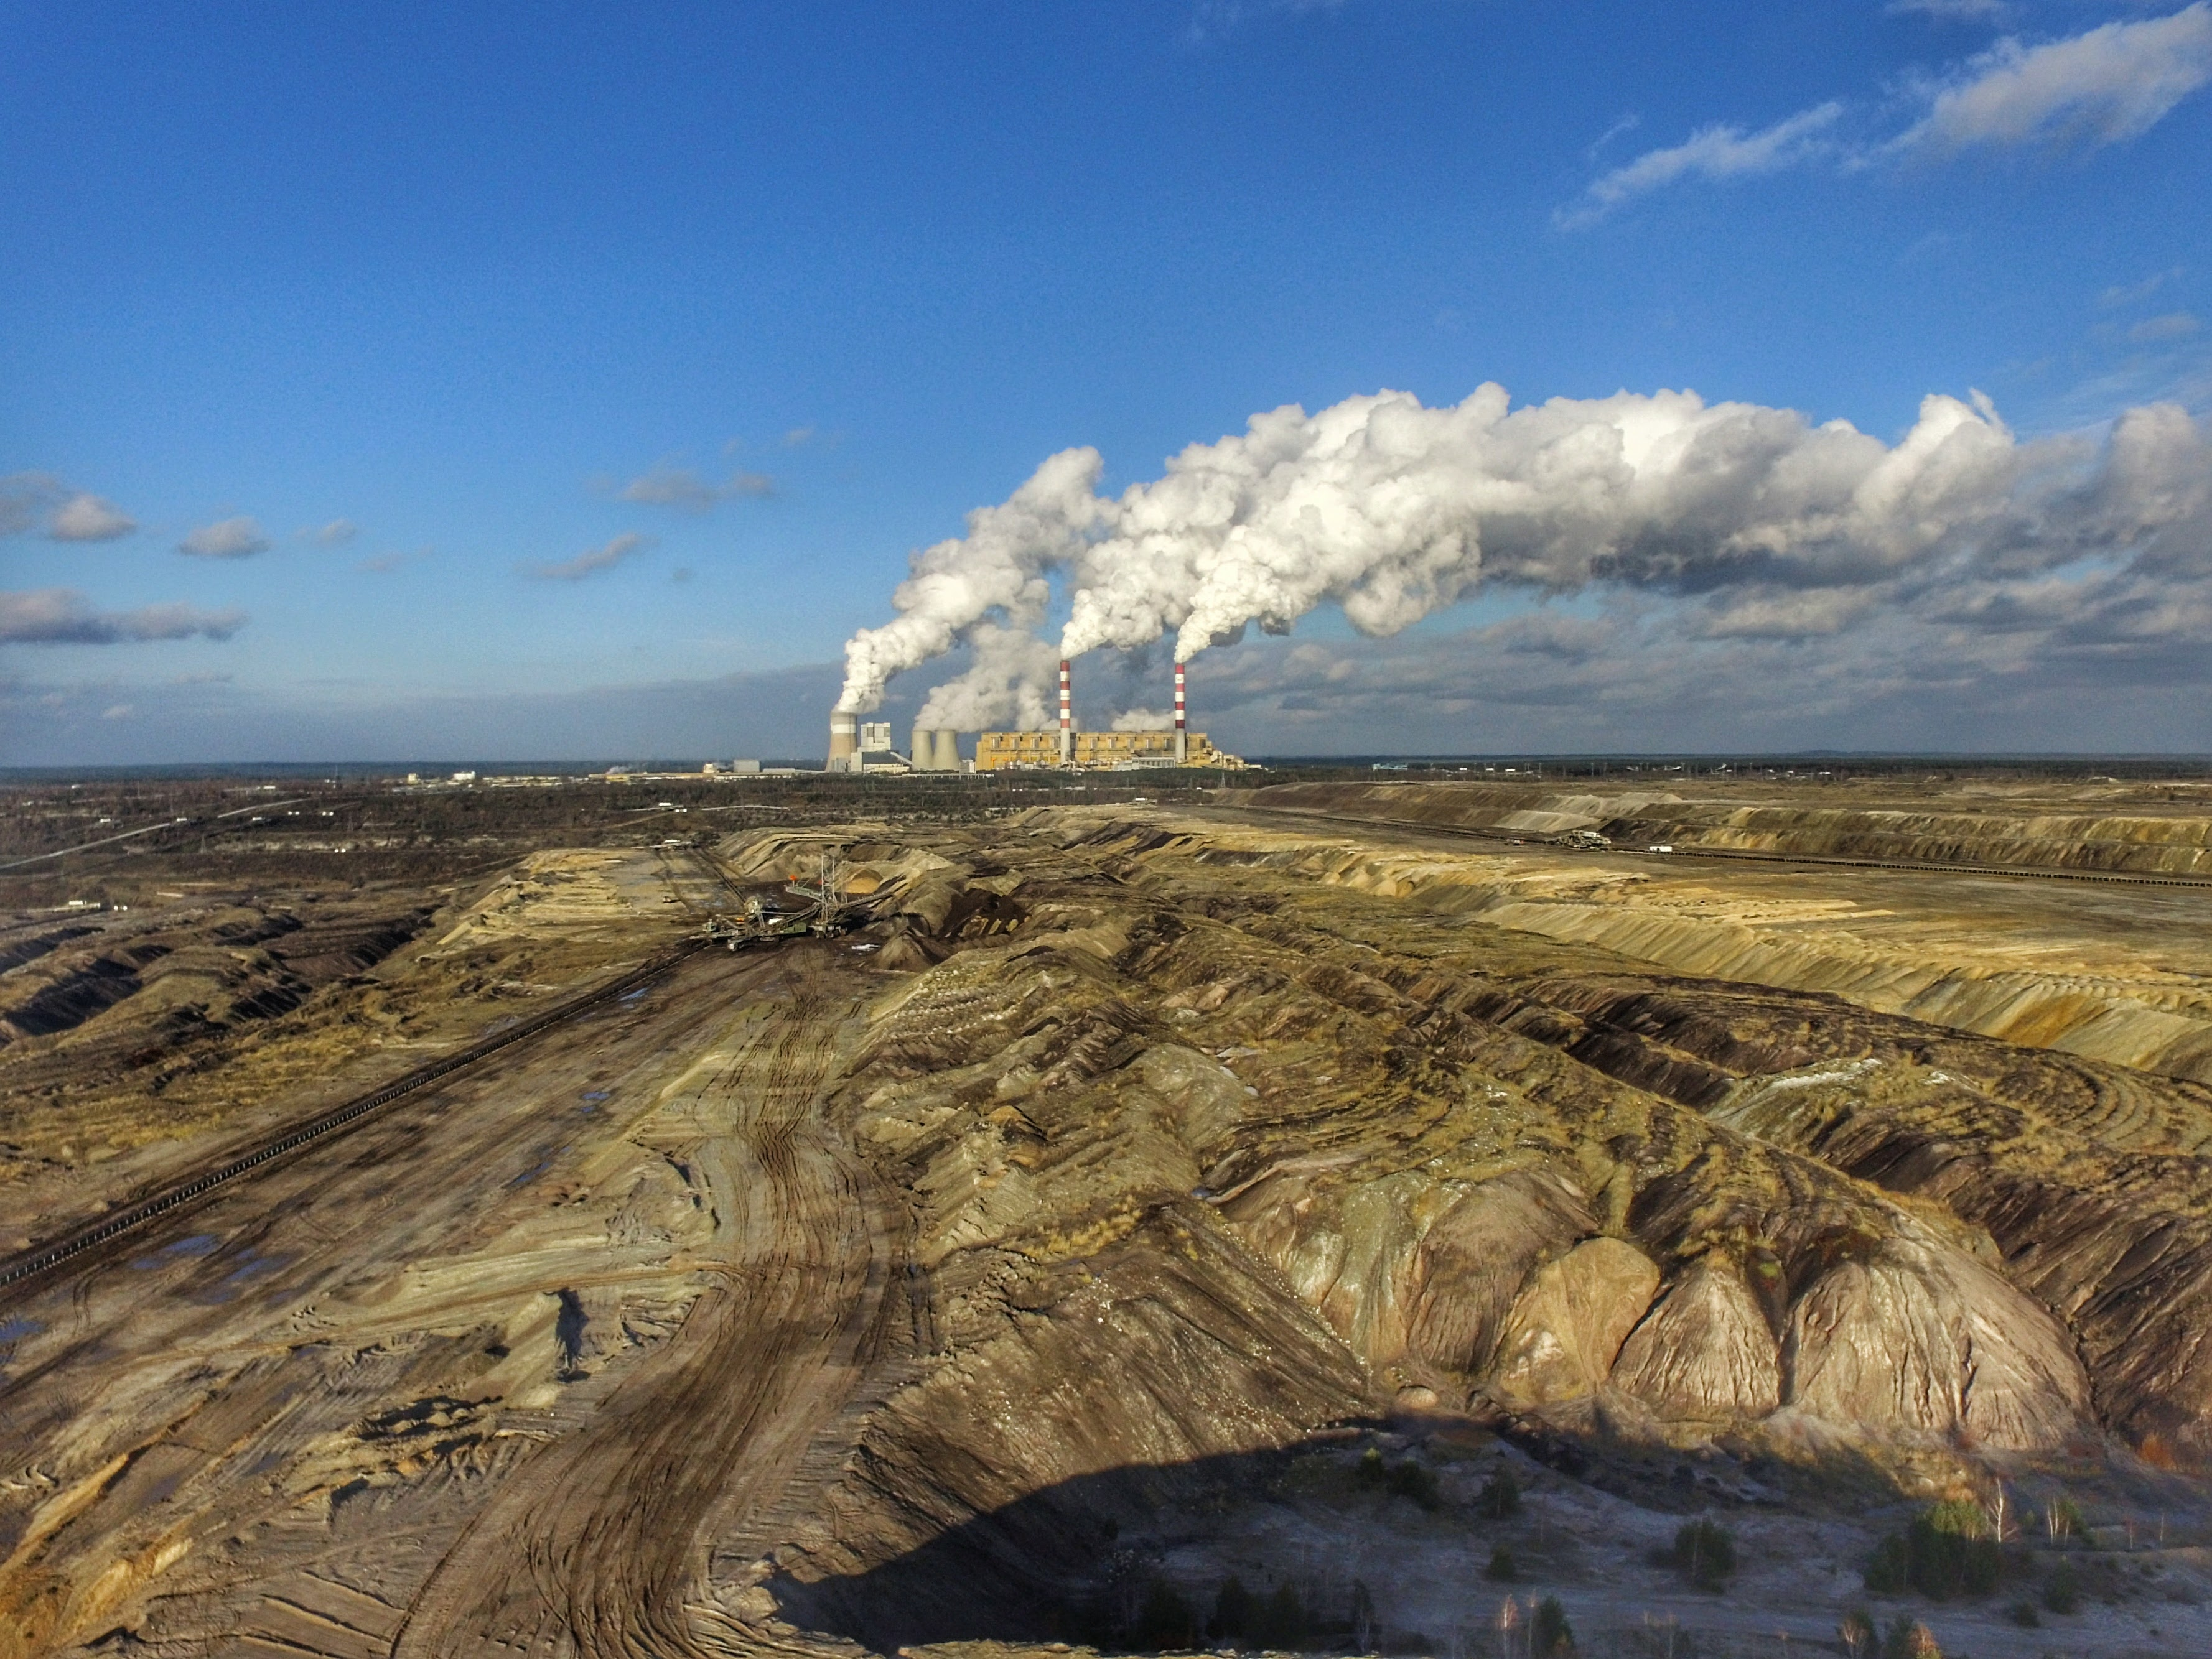
Notes:
That’s for modernising this

Slide 6

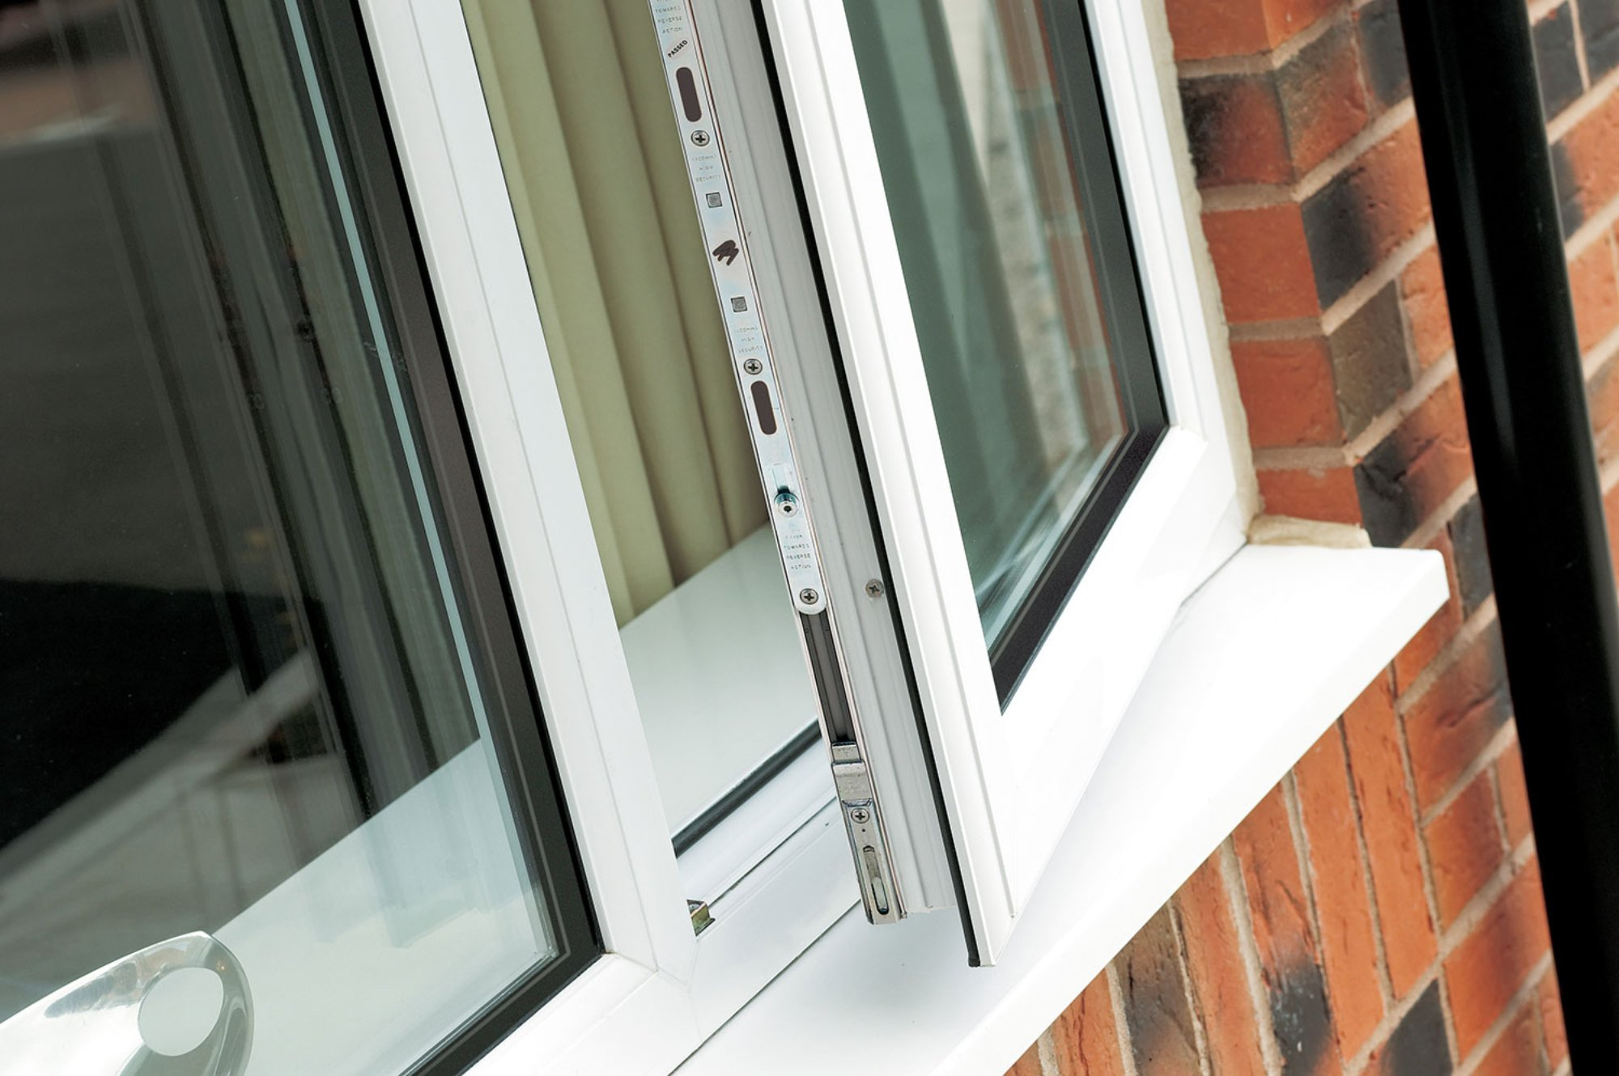
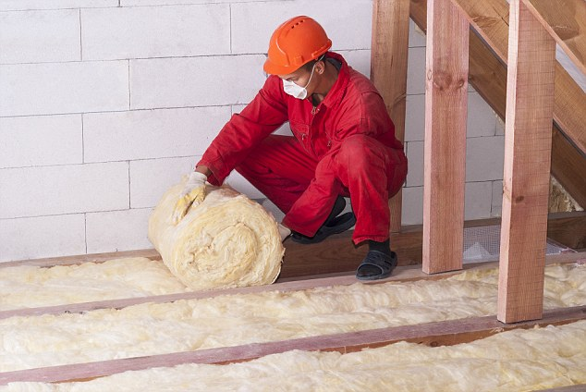
Notes:
But less glamorously for energy efficiency – making energy bills cheaper

Slide 7
Carbon trading in the ESR
Using the European community to make emission cuts in the cheapest places
Shifting finance to the low-hanging fruits: mainly from high-income to lower-income Member States
An internal mechanism only: good for Member States, and good for the climate

Slide 8
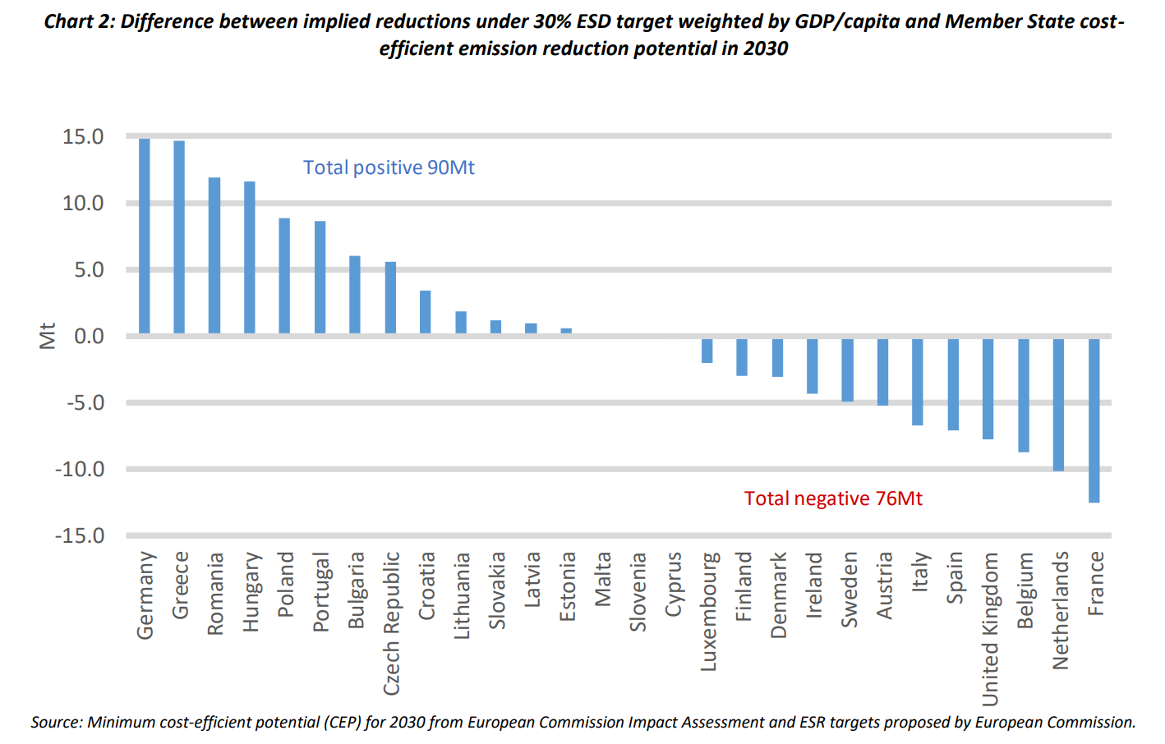
Notes:
https://sandbag.org.uk/wp-content/uploads/2017/05/The-European-Project-based-Mechanism-May-2017.pdf
The graph shows countries with the most cost-effective opportunities for emissions reductions (left-hand side), which might be potential project “hosts” – for agriculture, buildings, transport emission cuts
compared with those, on the right, with the fewest opportunities, which might be “sponsors”.

Slide 9
Why trade in the ESR?
Private sector | Greater private sector involvement and transfer of knowledge and technologies for emission reductions;
 | Initiates price discovery for the ESR sectors in the EU.
Member State | Economic boost and job creation in selling Member States. Cleaner air in cities, reduced health costs, reduced energy poverty and reduced fuel import dependency;
 | Savings incurred from cheaper compliance for wealthier Member States.
EU climate mitigation | Significant additional emission reductions could potentially be delivered;
 | Establishment of the actual share of cost-effective potential in ESR sectors compared to the ETS sectors.

Slide 10
A better fitting ESR
Just like the ETS, the ESR suffers with an enormous surplus of spare carbon allowances
Currently a billion allowances, growing to 1.7 billion by 2020
Why does this matter?
  No pressure as a climate policy, so fewer emissions reductions
  No potential for trading between states – Finance flows to lower GDP per capita states
Notes:
Trialogue tomorrow

Slide 11
Recap on the targets
EU-wide target: 40% emissions cuts by 2030
  ETS 43% cut
  ESR 30% cut
  (from 1990 levels)

Slide 12
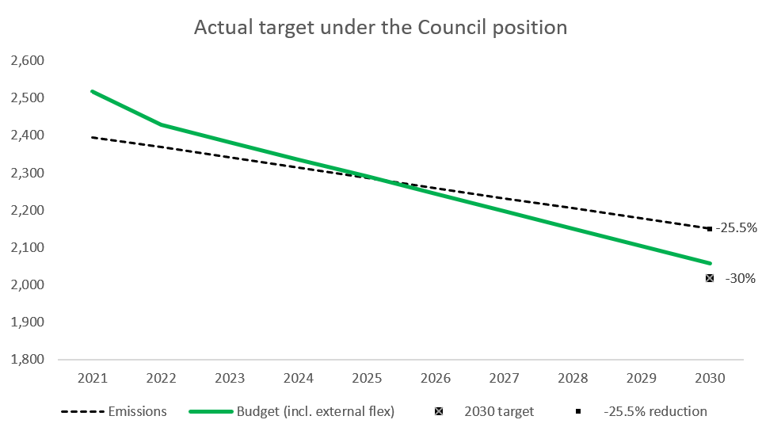
The problem
Notes:
Surplus carryover through the phase because of too high a starting point
And to a smaller extent external flexibilities (offsets)

Slide 13
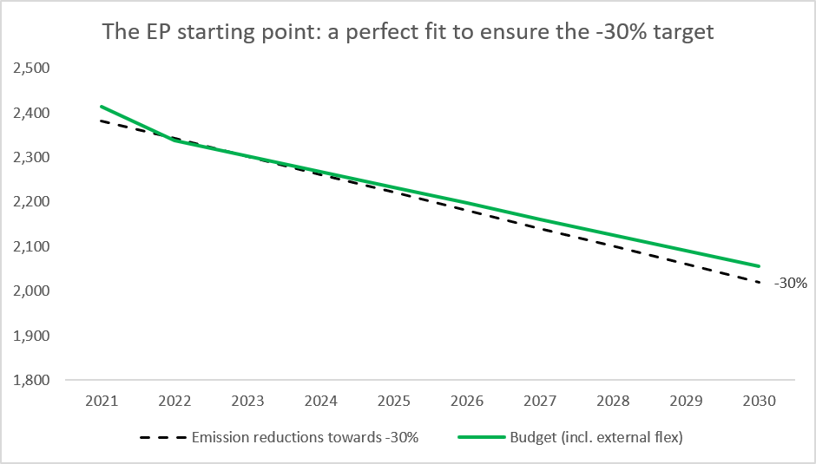
The solution
Notes:
A starting budget more closely lined up with emissions in 2020
Parliament position

Slide 14
In summary
Large ETS funds are available for CEE
Tomorrow’s ESR trialogue:
  Should introduce internal carbon trading
  Should follow the European Parliament position on the lower starting point

Slide 15
Thanks for your attention
Phil MacDonald
phil@sandbag.org.uk
Notes:
Intro Sandbag
Why Enviros and public, and gov?

